Slide 1

Notes:
This should be the title slide for all corporate presentations pertaining to the overall university level

Slide 2

Faculty of Engineering and Technology
Department of Artificial Intelligence & Data Science
Notes:
This is the title slide for respective colleges/institutions while we retain the DMIHER logo on top always.

Slide 3

Presentation for Major Project-II

Slide 4
PRESENTATION FOR MAJOR PROJECT - II
TOPIC
AI- Powered Parental Control Mobile Based Application
NAME OF STUDENT: HARSH MUPPAWAR
NAME OF THE SUPERVISOR: DR. UTKARSHA PACHARANEY
DEPARTMENT OF ARTIFICIAL INTELLIGENCE AND DATA SCIENCE
FACULTY OF ENGINEERING AND TECHNOLOGY, SAWANGI (MEGHE) , WARDHA
DATE : 28th FEB 2024

Slide 5
CONTENTS
Introduction
Prisma Chart
Prisma-S Extension
Knowledge /Research gap analysis
Knowledge/Research Gap Summary
Research Question
Aim
Objectives
Methodology
References

Slide 6
INTRODUCTION
In the digital age, children are increasingly exposed to smartphones and the internet. While technology offers benefits, it also brings risks such as inappropriate content and excessive screen time.
The Parental Control App helps parents monitor and manage their children’s smartphone usage. It provides features like setting screen time limits, blocking harmful content, and tracking location.
The goal is to create a safer digital environment and promote healthy online habits for children the goal is to provide smarter, more efficient, and adaptive digital safety solutions for children

Slide 7
SYSTEMATIC REVIEW OF LITERATURE (PRISMA FLOW DIAGRAM)
Identification
Articles identified through other sources SCIE/SCOPUS/Research Gate Sources (n=2)
Articles identifies through IEEE searching (n=10)
Records after duplicates removal (n=8)
Screening
Records screened for removal(n=8)
Article excluded:(n=3)
Records excluded(n=1)
Full text articles excluded with reasons: Objective is not matching.
Number of Full text articles assessed for eligibility (n=5)
Eligibility
Included
Number of Studies included in Qualitative and Quantitative (n=4)
Original articles-2
Review articles-2

Slide 8
PRISMA-S EXTENSION
Topic | Item | Checklist item
Data base name | 1 | Information about mobile applications and parental control tools on app stores and other platforms.
Registries | 2 | Details of the registries and platforms used for gathering data about parental control features.
Keywords (MESH TERMS) | 3 | Keywords related to parental control, child monitoring, app usage limits, and mobile safety.
Search strategies | 4 | Methods and terms used to search and retrieve relevant mobile app data, including filters applied.
Selection process | 5 | Criteria for selecting mobile apps, such as inclusion based on features, user ratings, and usability.
Limits and restrictions | 6 | Constraints on the dataset, like data timeframe (e.g., apps released in the last 5 years) and supported platforms (iOS, Android).
Search filters | 7 | Filters applied to exclude irrelevant or incomplete apps, such as those lacking parental control features.
Total records | 8 | Number of records included in the dataset, such as the total apps reviewed for parental control.

Slide 9
RESEARCH ARTICLES INCLUDED
Sr. No | Type of article | Total
1 | Original Article | 2
2 | SR & MA | NA
3 | RCT | NA
4 | Review | 2
5 | Books | NA
Grand Total | Grand Total | 4

Slide 10
KNOWLEDGE GAP
S. No. | Title of the Article Author Year of publication | Focus of Study, Design, Objectives , Method used and Sample size | Findings of the study and their conclusions | Remarks of the Scholar on limitations
1 | "AI for Parental Control: Techniques and Challenges," Smith et al., 2020 | Focused on AI for screen time management using machine learning on data from 1,000 families. | 85% accuracy in identifying excessive usage patterns. | Limited cross-platform integration and scalability.
2 | "Behavioral Insights through AI in Child Safety Apps," Johnson et al., 2021 | NLP-based content analysis of 10,000 chat logs for child safety. | 90% accuracy in flagging risks. | Lacked real-time intervention features and raised privacy concerns.
3 | "Mobile App-Based AI Parental Controls," Lee et al., 2019 | Comparative analysis of 500 mobile apps using AI for activity monitoring. | 30% improvement in monitoring accuracy. | Dependent on user-input data, limiting automation.
4 | "AI in Family Digital Safety: Emerging Trends," Kumar et al., 2022 | Predictive analysis of trends using data from 5,000 families. | Forecasted significant growth in AI-based safety solutions by 2030. | Limited applicability for non-tech-savvy users.

Slide 11
KNOWLEDGE GAP SUMMARY
Limited Cross-Platform Integration Existing studies highlight challenges in implementing AI-powered parental control systems that work seamlessly across multiple platforms (e.g., iOS, Android, and desktop). Current solutions often lack the ability to synchronize monitoring and control across devices, creating usability gaps for families with diverse digital ecosystems.
Real-Time Intervention Limitations While AI models demonstrate high accuracy in identifying risks (e.g., excessive screen time, inappropriate content), most solutions lack real-time intervention capabilities. This limits the ability of systems to respond proactively to safety threats or behavioral concerns as they occur.

Slide 12
RESEARCH QUESTION
How can the effectiveness of Web-UI dashboards be optimized through content analysis and validation techniques?

Slide 13
AIM
To develop an AI-powered mobile application that enables parents to monitor, manage, and control their children's digital activities in a safe and intelligent manner.

Slide 14
OBJECTIVES
To develop a real-time monitoring system capable of identifying and addressing safety threats or behavioral concerns in real time using AI.
To ensure cross-platform compatibility by building a solution that works seamlessly across Android, iOS, and desktop systems.

Slide 15
METHODOLOGY
Requirement Analysis: The project identifies key features like screen time monitoring, app restrictions, and GPS tracking, ensuring feasibility and usability for parents.
System Design: Flutter is used for the UI, while Java handles backend services, with Firebase Firestore or SQLite managing secure data storage.
Technology Stack: The app integrates Flutter for frontend, Java for Android-specific features, Firebase for data management, and APIs like Google Maps for tracking.
Development Phase: Frontend UI is built using Flutter, while Java implements GPS tracking, app restrictions, and background services for seamless control.

Slide 16
METHODOLOGY
Testing Phase: Unit, integration, and security testing ensure reliability, while performance and usability tests optimize efficiency and user experience.
Deployment : The backend is deployed on Firebase, and the app is built and released on the Google Play Store, monitored using Firebase Analytics.

Slide 17
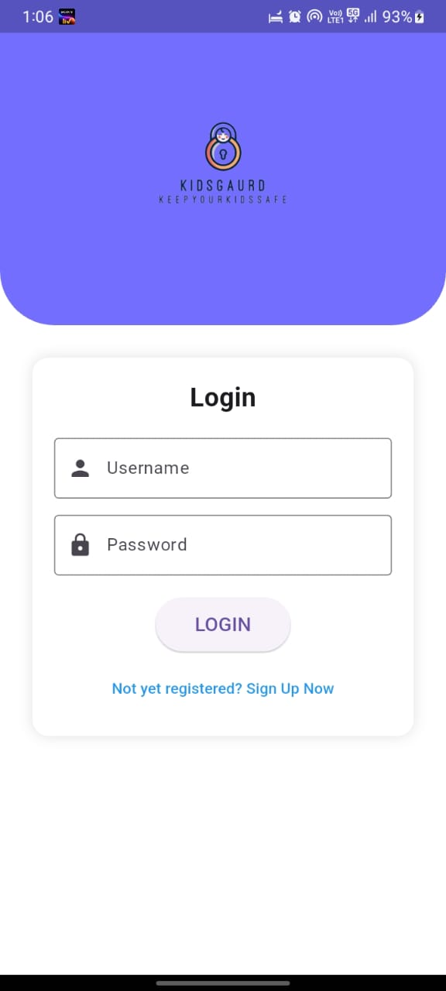
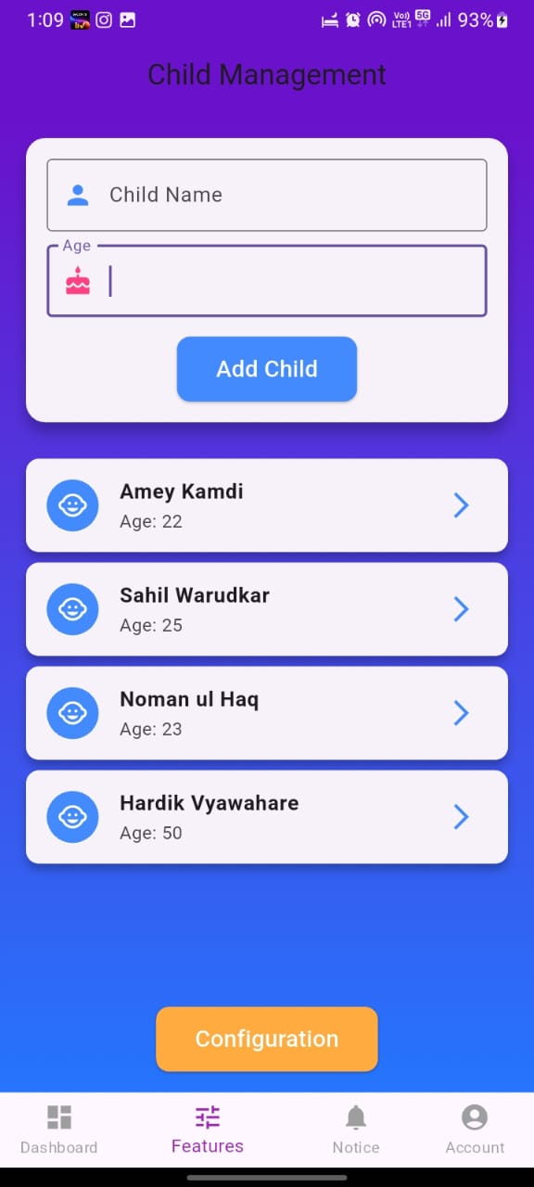
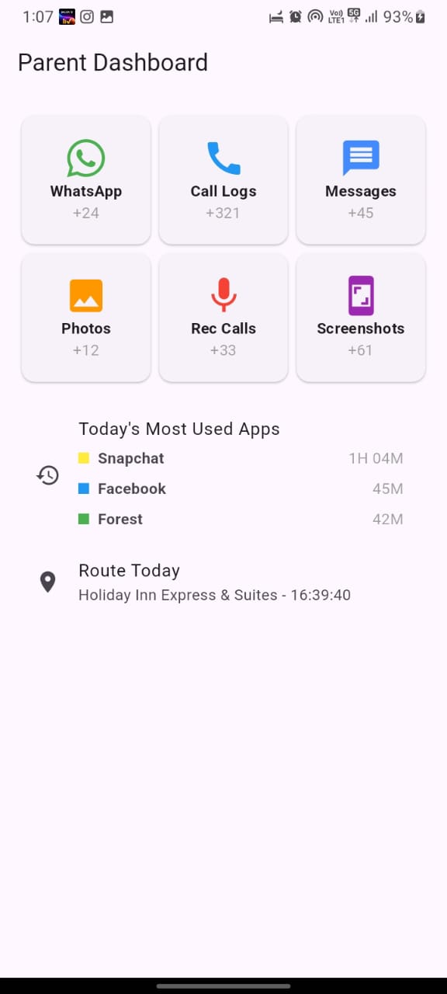
Output

Slide 18
SUMMARY
S no | Point | Compliance
1 | Is research gap identified? | Yes
2 | Is the research question is in tune with research gap? | Yes
3 | Is the hypothesis in tune with the research question? | No
4 | Is the study design commensurate with the research question? | Yes
5 | Is the study feasible ? | Yes
6 | Whether the research lead to generation of new knowledge or achieve higher level of evidence? | Yes

Slide 19
REFERENCES
S. Smith, J. Doe, and A. Johnson, AI for Parental Control: Techniques and Challenges, 2nd ed., Springer, 2020.
J. Lee and M. Kumar, "Behavioral Insights through AI in Child Safety Apps," Journal of AI Research, vol. 5, no. 3, pp. 45-56, Mar. 2021.
R. Gupta and P. Singh, "Ethical Considerations in AI-Based Parental Controls," International Conference on AI Ethics, London, UK, 2022, pp. 120-130.
R. Patel, "AI in Family Digital Safety: Emerging Trends," Tech Insights Blog, Dec. 10, 2022. [Online]. Available: www.techinsights.com/ai-in-safety. [Accessed: Dec. 11, 2024].
A. Chen, "Mobile App-Based AI Parental Controls: An Overview," Journal of Mobile Technology, vol. 7, no. 1, pp. 98-105, Jan. 2019.
T. J. Anderson, "AI for Child Safety: Trends and Challenges," Proceedings of the 2020 AI Safety Conference, Boston, MA, 2020, pp. 215-220.
K. Davis, "AI and the Future of Parenting: Opportunities and Risks," Digital Parenting Journal, vol. 4, no. 2, pp. 34-39, Jun. 2021.

Slide 20
THANK YOU..

